Slide 1


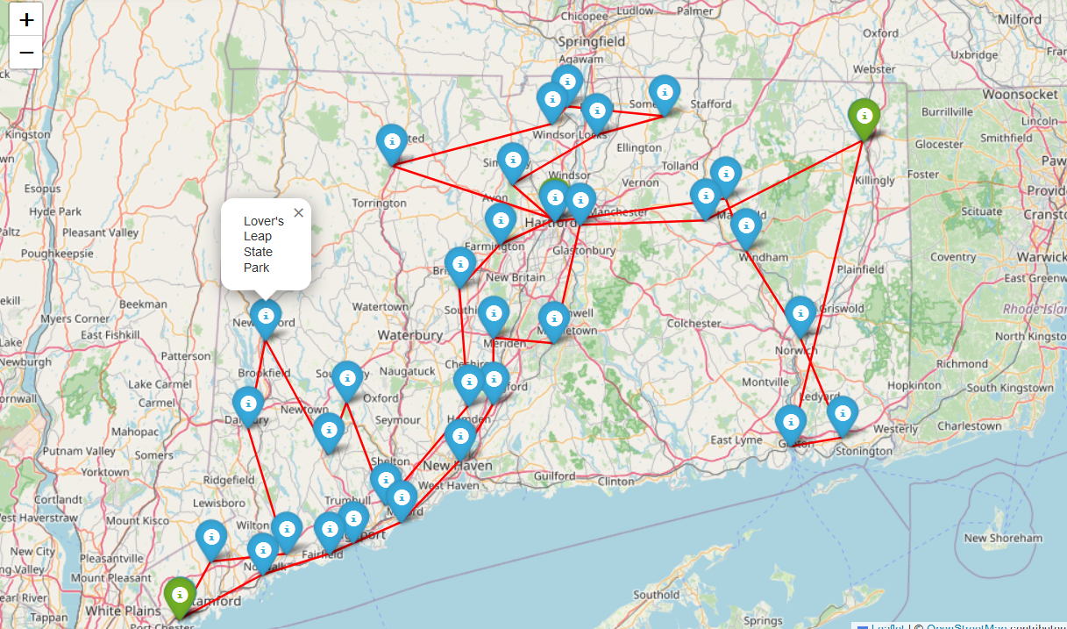
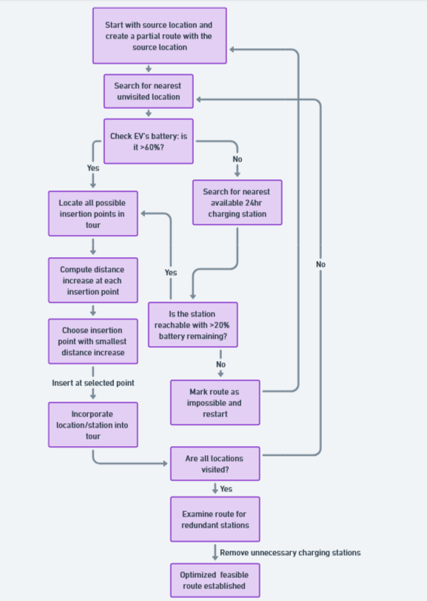

Electric Vehicle Route Optimization with Nearest Insertion algorithm
Promi Roy
Supervisor: Dr. Joseph DeMaio
INTRODUCTION
OPTIMIZED ROUTE IN MAP
PYTHON CODE
Over recent decades, the combustion of fuels has significantly impacted Earth's atmosphere. The burning of hydrocarbons plays a critical role in ozone layer depletion, the greenhouse effect, and various environmental issues. These dangers have propelled efforts to minimize fuel consumption in vehicles, leading to the emergence of electric vehicles (EVs). Unlike traditional vehicles that run on petrol or diesel, EVs are powered by batteries or other electric sources. In 2013, transportation was responsible for over half of the nitrogen oxide and carbon monoxide emissions and nearly a quarter of the hydrocarbon emissions, posing substantial risks to both human health and the environment. The adoption of EVs and recent advancements in the industry could dramatically lower the pollution from transport vehicles. Electric vehicles represent the future of transport, offering low emissions and benefiting the atmosphere. They rely on rechargeable batteries, requiring charging stations instead of petrol pumps. The switch to battery power over internal combustion engines simplifies the vehicle's design, making it more compact and durable.
Graph Theory algorithms design a route planning specifically for electric vehicles by finding an energy-optimal solution while simultaneously considering stress on the battery. One of the algorithms is the Nearest Insertion Algorithm which we will use in our EVs route optimization analysis. The motivation for this route is to visit all interesting locations in Connecticut State.
def nearest_insertion_algorithm(location_distance_matrix, qualifying_distance_matrix, charging_station_distance_matrix, places_df, charging_stations_df, source_city, vehicle_params, charging_params, iteration_count=0):
current_tour = [source_city]
visited_cities = set(current_tour)
current_charge = charging_params['max_charge']
total_distance = 0
speed_dict = {}
Cd, A, Crr, m, g, rho, lambda_, alpha = vehicle_params.values()
level2_charge_rate, dc_fast_charge_rate, min_charge, max_charge = charging_params.values()
while len(set(current_tour) & set(places_df["Locations"])) < len(places_df["Locations“])
nearest_location = find_nearest_location(current_tour, location_distance_matrix, qualifying_distance_matrix, places_df, charging_stations_df)
distance_to_next_location = location_distance_matrix.at[current_tour[-1], nearest_location]
speed = random.randint(50, 80) # Random speed between 50 and 80 miles/h
speed_dict[(current_tour[-1], nearest_location)] = speed # Store the speed in the speed_dict
speed_dict[(nearest_location, current_tour[-1])] = speed # Also store the speed for the reverse direction
print(f"Speed stored in speed_dict: {current_tour[-1]} -> {nearest_location}: {speed} miles/h")
print(f"Speed stored in speed_dict: {nearest_location} -> {current_tour[-1]}: {speed} miles/h")
print(f"Speed stored in speed_dict: {current_tour[-1]} -> {nearest_location}: {speed} miles/h")
discharge_rate = calculate_battery_discharge_rate(distance_to_next_location, speed, Cd, A, Crr, m, g, rho, lambda_, alpha)
required_charge_to_next_location = discharge_rate
print(f"Current charge: {current_charge}, Required charge to next location: {required_charge_to_next_location}")
if current_charge - required_charge_to_next_location >= min_charge:
insert_nearest_location(nearest_location, current_tour, location_distance_matrix, qualifying_distance_matrix, charging_station_distance_matrix, places_df, charging_stations_df)
visited_cities.add(nearest_location)
total_distance += distance_to_next_location
current_charge -= required_charge_to_next_location
print("Updated Tour:")
for city in current_tour:
print(f"Nearest Location: {city}")
print(f"Total Distance: {total_distance}")
print(f"Updated Charge: {current_charge}")
print(f"Speed: {speed} miles/h")
# Check if charge level is below 60% and find the nearest charging station
if current_charge < max_charge * 0.6:
print("Warning: Charge level below 60%. Looking for the nearest charging station.")
nearest_station = find_nearest_charging_station(current_tour, qualifying_distance_matrix, charging_station_distance_matrix, places_df, charging_stations_df)
if nearest_station is not None:
insert_nearest_charging_station(nearest_station, current_tour, location_distance_matrix, qualifying_distance_matrix, charging_station_distance_matrix, places_df, charging_stations_df)
visited_cities.add(nearest_station)
distance_to_station = get_distance(current_tour[-2], nearest_station, location_distance_matrix, qualifying_distance_matrix, charging_station_distance_matrix, places_df, charging_stations_df)
current_charge = max_charge
print("Total Distance After Charging Station Insertion:", total_distance)
else:
print(f"Impossible route encountered after {iteration_count} iterations. Restarting with a different source city.")
new_source_city = places_df.loc[places_df["Locations"] != source_city, "Locations"].sample().values[0]
return nearest_insertion_algorithm(location_distance_matrix, qualifying_distance_matrix, charging_station_distance_matrix, places_df, charging_stations_df, new_source_city, vehicle_params, charging_params, iteration_count + 1)
print(f"Nearest Insertion Algorithm completed after {iteration_count} iterations.")
print("Tour:")
for city in current_tour:
if city in places_df["Locations"].values:
print(f"Nearest Location: {city}")
else:
print(f"Nearest Charging Station: {city}")
if all(location in current_tour for location in places_df["Locations"]):
print("Feasible route found.")
print_final_tour(current_tour, places_df, charging_stations_df, total_distance)
return current_tour, total_distance, speed_dict
else:
print(f"Impossible route encountered after {iteration_count} iterations. Restarting with a different source city.")
new_source_city = places_df.loc[places_df["Locations"] != source_city, "Locations"].sample().values[0]
return nearest_insertion_algorithm(location_distance_matrix, qualifying_distance_matrix, charging_station_distance_matrix, places_df, charging_stations_df, new_source_city, vehicle_params, charging_params, iteration_count + 1)
vehicle_params = {
'Cd': 0.3,
'A': 2.2,
'Crr': 0.01,
'm': 1500,
'g': 9.81,
'rho': 1.225,
'lambda_': 0.80,
'alpha': 0.25
charging_params = {
'level2_charge_rate': 7,
'dc_fast_charge_rate': 50,
'min_charge': 20, # 20% of 100 kWh battery capacity
'max_charge': 90 # 90% of 100 kWh battery capacity
}
a
METHODS
In our route optimization problem, our goal was to find the optimal route to visit our desired location of cities in Connecticut State. The overall goal of this is to find an optimized route for an EV to visit multiple locations while ensuring that the battery charge is sufficient to reach the next destination or a charging station and that the EV always maintains at least 20% charge remaining. We employed the Nearest Insertion algorithm by repeatedly selecting the nearest unvisited city or charging station from the current location.
Nearest Insertion Algorithm: The Nearest Insertion Algorithm is a method used in solving routing problems, such as the Traveling Salesman Problem (TSP), which seeks to find the shortest possible route that visits a set of locations once and returns to the starting point. This is one of the heuristic approaches that aims to construct a tour by iteratively adding the nearest not-yet-visited city to the tour. It's a relatively simple and intuitive method that can produce good solutions for small to medium-sized problems. Here's a step-by-step breakdown of how the algorithm works:
1. We start with an arbitrary point as the initial partial tour (this can be any city from the set of cities to be visited) and mark this point as visited.
2. Then we find the nearest unvisited city to the tour. This can be done by checking the distances from all cities in the partial tour to all unvisited cities and selecting the minimum.
3. We insert this nearest city into the tour at the position where it will cause the least increase in the tour's length. This involves checking all possible positions where the new city could fit between two consecutive cities in the current tour and selecting the one that minimizes the increase in total distance.
4. We mark the newly added city as visited. Then repeat steps 2 and 3 until all cities are included in the tour.
Let's go through every detail of the Nearest Insertion Algorithm using the given example.
Given:
- Four cities: A, B, C, and D
- Distance matrix:
A to B: 5
A to C: 2
A to D: 7
B to C: 4
B to D: 3
C to D: 6
Step 1: Start with a subtour consisting of a single city (usually the starting city).
- We start with the sub-tour [A].
Step 2: Find the city that is nearest to any city in the current subtour and not already included in the subtour.
- We look at the distances from A to the other cities:
- A to B: 5
- A to C: 2
- A to D: 7
- The nearest city to A is C, with a distance of 2.
Step 3: Insert the nearest city into the subtour at the position that results in the minimum increase in the subtour's length.
- We insert C into the sub-tour [A].
- Since there is only one position to insert C, we add it after A.
- The resulting subtour is [A, C].
Step 4: Repeat steps 2 and 3 until all cities are included in the tour.
Iteration 1:
- Current sub tour: [A, C]
- We look at the distances from the cities in the sub-tour to the remaining cities:
- A to B: 5
- A to D: 7
- C to B: 4
- C to D: 6
- The nearest city to the sub-tour [A, C] is B, with a distance of 4 (from C to B).
- We now consider the positions to insert B in the sub-tour [A, C]:
1. We insert B between A and C: [A, B, C]
- Increase in sub-tour length: (A to B) + (B to C) - (A to C) = 5 + 4 - 2 = 7
2. We insert B after C: [A, C, B]
- Increase in sub-tour length: (c to B) = 4
- Inserting B after C creates the smallest increase
- Let's insert B between A and C, resulting in the subtour [A, C, B].
Iteration 2:
- Current sub tour: [A, C, B]
- The only remaining city is D.
- We consider the positions to insert D in the sub-tour [A, B, C]:
1. We insert D between A and C: [A, D, B, C]
- Increase in sub-tour length: (A to D) + (D to C) - (A to C) = 7 + 6 - 2 = 11
2. Insert D between C and B: [A, C, D, B]
- Increase in sub-tour length: (C to D) + (D to B) - (C to B) = 6 + 3 - 4 = 5
3. Insert D after B: [A, C, B, D]
- Increase in sub-tour length: (B to D) = 3
- Inserting D after B results in the minimum increase in subtour length (5 units).
- The final tour [A, C, B, D, A].
The final tour obtained by the Nearest Insertion Algorithm is [A, B, D, C, A] with a total distance of 5 + 3 + 6 + 2 = 16 units
EV ROUTE OPTIMIZATION FLOW CHART
Optimized Final Tour:
Nearest Location: Yale University
Nearest Location: Wharton Brook State Park
Nearest Location: Hubbard Park
Nearest Location: Wadsworth Falls State Park
Nearest Location: Pratt & Whitney Stadium at Rentschler Field
Nearest Location: Patriots Park
Nearest Location: Rotary Park & Bandstand
Nearest Charging Station: Cargill Chevrolet, 23 Livery St
Nearest Location: Fort Trumbull State Park
Nearest Location: Mystic Seaport Museum
Nearest Location: Mohegan Park
Nearest Location: Windham Textile & History Museum
Nearest Location: University of Connecticut
Nearest Location: Connecticut State Capitol
Nearest Location: Talcott Mountain State Park
Nearest Location: Connecticut Trolley Museum
Nearest Location: Shenipsit State Forest
Nearest Location: Phelps-Hatheway House & Garden
Nearest Location: New England Air Museum
Nearest Location: Burr Pond State Park
Nearest Charging Station: Greater Hartford Transit District - Spruce Street Lot, 1 Union Pl
Nearest Location: Hill-Stead Museum
Nearest Location: Lake Compounce
Nearest Location: Sleeping Giant State Park
Nearest Location: Boothe Memorial Park and Museum
Nearest Location: Kettletown State Park
Nearest Location: Pequonnock River Trail
Nearest Location: Lover's Leap State Park
Nearest Location: Tarrywile Park & Mansion
Nearest Location: Westport Country Playhouse
Nearest Location: Stamford Museum & Nature Center
Nearest Location: Bruce Museum
Nearest Charging Station: Delamar Greenwich Harbor - Tesla Destination, 500 Steamboat Rd
Nearest Location: The Maritime Aquarium
Nearest Location: Fairfield Museum and History Center
Nearest Location: Seaside Park
Nearest Location: Silver Sands State Park
Best Cost (Total Distance): 382.77497307499084
DISCUSSION
Here our goal is to visit our desired locations (State Capitols, Museums, National Parks) in Connecticut State. We proposed the Nearest Insertion algorithm to visit these locations. Here’s how we started our journey:
1. We start with the source location and initialize a partial route containing only the source location.
2. We look for the unvisited location that is nearest to any location in the current partial route. While choosing, the nearest location should be the nearest among locations or charging stations already included in the partial tour.
3. We then check if the EV has sufficient battery charge to reach the nearest city until the EV’s charge falls below 60%.
If yes, we insert the nearest unvisited charging station into the current tour at the optimal position. We iterate over all possible insertion points in the current tour. For each insertion point, we calculate the increase in distance if the nearest location is inserted at that point, using the appropriate distance matrix based on the places (locations and charging stations already included in the current tour) before and after the insertion point. We keep track of the insertion point which results in the minimum increase in distance. If a suitable insertion point is found, we insert the nearest location into the current tour at that position.
If not, we will find the nearest charging station that is available 24 hours a day and has either EV level 2 or EV DC Fast charging technology. While choosing, the nearest charging station should be the nearest among locations and charging stations already included in the partial tour.
4. If a suitable charging station is found we check if the EV can reach it with at least 20% charge remaining.
If yes, we insert the nearest unvisited charging station into the current tour at the optimal position. We iterate over all possible insertion points in the current tour. For each insertion point, we calculate the increase in the distance if the nearest charging station is inserted at that point, using the appropriate distance matrix based on the places (locations and charging stations already included in the current tour) before and after the insertion point. We keep track of the insertion point which results in the minimum increase in distance. If a suitable insertion point is found, we insert the nearest charging station into the current tour at that position.
If no suitable charging station is found or the EV cannot reach any charging station with sufficient charge, we mark the route as impossible.
5. If an impossible route is encountered, we will repeat steps 1 to 4 until a feasible route is found that includes all the locations.
As we are using the nearest insertion algorithm, there is a possibility that multiple charging stations may come between two locations which can be redundant. A driver might not stop at every charging station between two locations. In that case, we remove those redundant charging stations, and thus we get a revised optimized route.
REFERENCE
CODE
Implementation of charging station based electric vehicle routing problem using nearest neighbour search algorithm
September 2017
DOI: 10.1109/ICITE.2017.8056880
Conference: 2017 2nd IEEE International Conference on Intelligent Transportation Engineering (ICITE)
Abdur Rahman Daanish
Bhukya Krishna Naick

